Slide 1
Lab 3 Cross table query
United International College

Slide 2
Motivation
Sometimes a single table does not contain all desired attributes.
For example, one wants to find all cities in China.
  City information is in the table city=(city_id, city, country_id, last_update).
  But “China” is a value for attribute country in the table country.
  And city only has country_id.
It is doable to find the country id for China first, then write another query to find the cities.
But how can this be done in one query?

Slide 3
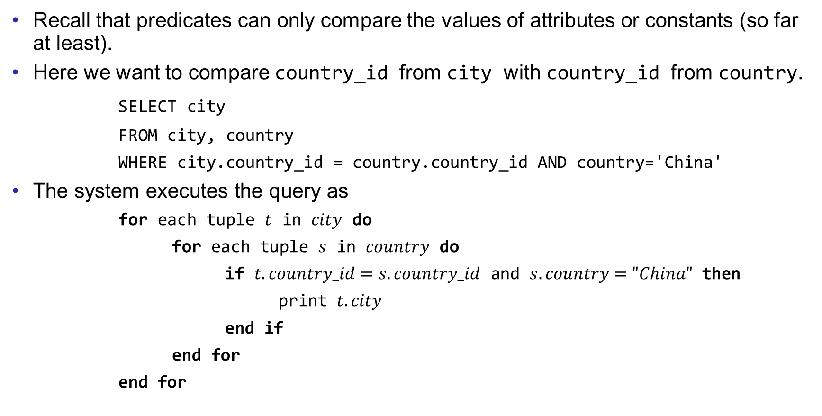
Cross table
Recall that predicates can only compare the values of attributes or constants (so far at least).
Here we want to compare country_id from city with country_id from country.
SELECT city
FROM city, country
WHERE city.country_id = country.country_id AND country='China'
The system executes the query as
for each tuple $t$ in $city$ do
for each tuple $s$ in $country$ do
if $t.country_id=s.country_id$ and $s.country="China"$ then
print $t.city$
end if
end for
end for

Slide 4



Cross table
Equivalent to querying from a (temporary) table city$×$country, the cartesian product of city and country.
For example,
SELECT city FROM temp WHERE city.country_id=country.country_id AND country='China'
To distinguish the two country_id, we use city.country_id and country.country_id.
The attribute city does not need city.city, because there is no other attribute with the same name. (Same for country.)
city.
country.
city_id | city | country_id
1 | Beijing | 1
2 | Tokyo | 2
country_id | country
1 | China
2 | Japan
city_id | city | country_id | country_id | country
1 | Beijing | 1 | 1 | China
2 | Tokyo | 2 | 1 | China
1 | Beijing | 1 | 2 | Japan
2 | Tokyo | 2 | 2 | Japan
$$×$$
$$=$$

Slide 5
Examples
Find the phone number of the customer Lisa Anderson.
Find the language of the film “Angels Life”.

Slide 6
Keys
Find the films played by Angela (actor’s first name).
SELECT actor.actor_id, first_name, last_name, film.title
FROM actor, film_actor, film
WHERE first_name = 'Angela' AND
actor.actor_id = film_actor.actor_id AND
film_actor.film_id = film.film_id
Why we need to select the id, first name, and last name of the actor?

Slide 7
Keys
There are two actors whose first name is “Angela”, Angela Hudson and Angela Witherspoon.
To distinguish the films played by which Angela, we need actor id, which is the key of the schema.
The key of a schema is a set of one or multiple attributes, which can uniquely define the tuples in the table.
E.g. actor_id is the key of actor.
Again, the meaning of keys in schemas is similar but not the same as keys in ER diagrams.

Slide 8
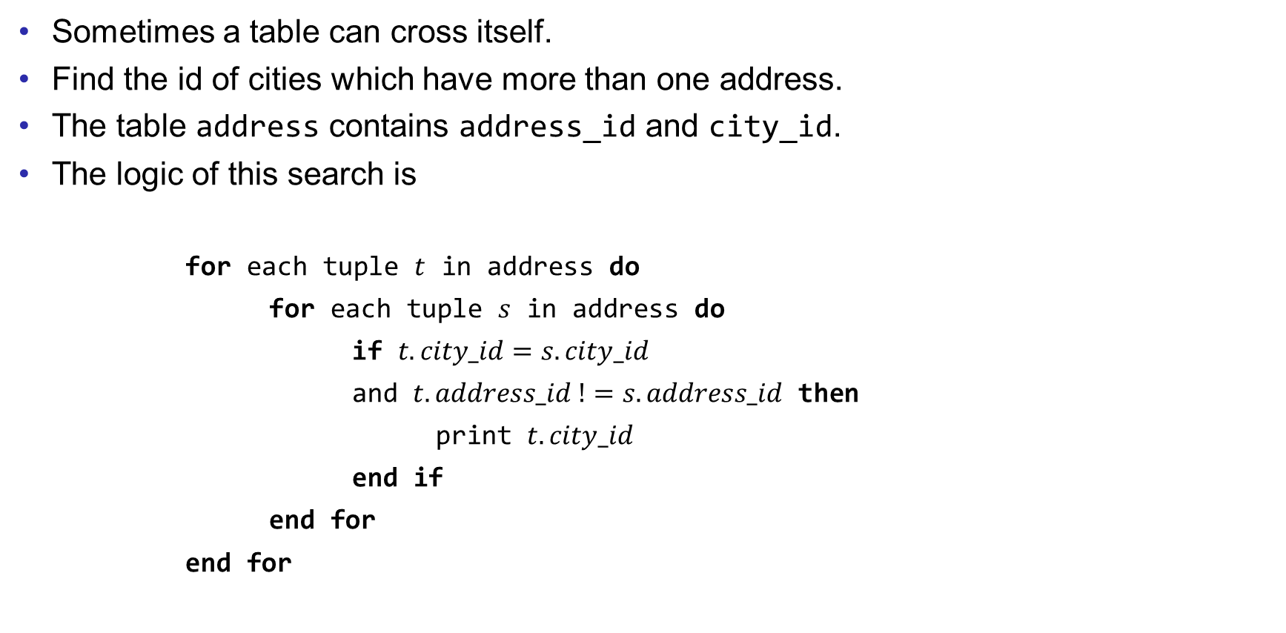
A table times itself
Sometimes a table can cross itself.
Find the id of cities which have more than one address.
The table address contains address_id and city_id.
The logic of this search is
for each tuple $t$ in address do
for each tuple $s$ in address do
if $t.city_id=s.city_id$
and $t.address_id !=s.address_id$ then
print $t.city_id$
end if
end for
end for
The nested loop is implemented by the table address crossing with itself.

Slide 9
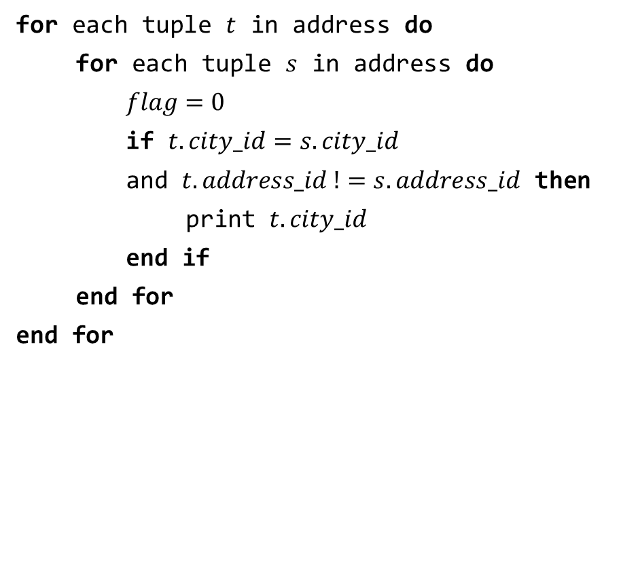
A table times itself
for each tuple $t$ in address do
for each tuple $s$ in address do
$flag=0$
if $t.city_id=s.city_id$
and $t.address_id !=s.address_id$ then
print $t.city_id$
end if
end for
end for
SELECT a1.city_id
FROM address AS a1, address AS a2
WHERE a1.city_id = a2.city_id AND
a1.address_id <> a2.address_id
The two tables are renamed by “AS”, to avoid ambiguous.
If two tuples agree on city_id but have different address_id, this city_id has multiple addresses.
<> means not equal.

Slide 10
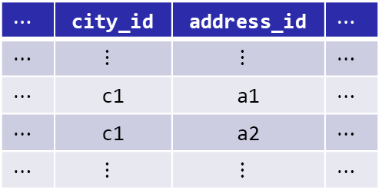
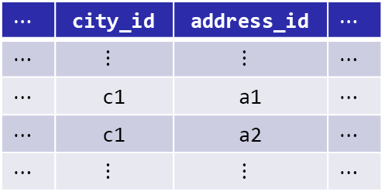
A table times itself
Why some results are duplicated?
One pair is matched twice.
Use DISTINCT to remove duplications from result.
Outer loop for a1
Inner loop for a2
$$⋯$$ | city_id | address_id | $$⋯$$
$$⋯$$ | $$⋮$$ | $$⋮$$ | $$⋯$$
$$⋯$$ | c1 | a1 | $$⋯$$
$$⋯$$ | c1 | a2 | $$⋯$$
$$⋯$$ | $$⋮$$ | $$⋮$$ | $$⋯$$
$$⋯$$ | city_id | address_id | $$⋯$$
$$⋯$$ | $$⋮$$ | $$⋮$$ | $$⋯$$
$$⋯$$ | c1 | a1 | $$⋯$$
$$⋯$$ | c1 | a2 | $$⋯$$
$$⋯$$ | $$⋮$$ | $$⋮$$ | $$⋯$$

Slide 11
Example
Find the name (first and last) of actors who have the same first name with another actor.

Slide 12
Exercises
Write SQLs for the following questions.
Find the films (name) played by Zero Cage.
Find the films (name) rented by George Linton.
Find the customers (name) who have rented some action (category) films.
Find the customers who live in China and have rented some English films.
Find all pairs of customers (name) who have rented a same film.
Find the actors who have played a same film with Bolger (the last name of an actor)
Save your queries in a txt file. Rename it as “COMP3013 Lab3 ###.txt”, where “###” is your student ID. And submit it on iSpace. The DDL is 24 hours after the lab.

Slide 13
End of Lab 3

